Slide 1
CPMR Department Meeting
April 8, 2019

Slide 2
New Employees
Megan Munyan – Program Assistant (AoU)
David Brown – Study Coordinator-Chippewa Falls (AoU)
Megan Zettler - Study Coordinator-Chippewa Falls (AoU)

Slide 3
Tornado and Fire Drills
MCHS requires a review of the Department Emergency Evacuation Procedure and takes part in Tornado and Fire drills regularly.
April 11, 2019 is the Wisconsin Tornado Drill day.
All CPMR employees are expected to take part in all drills.
The only exception is if you are on a phone conference when the drill occurs.
If your main center is not Marshfield, please check with Security at your center for evacuation instructions.

Slide 4
Tornado and Fire Drills cont.
For a Tornado Drill, seek a non-windowed internal room. Close all blinds and the door to your office.
MLR: Mini Conference Room I, ML4A/B Conference Room, restrooms
ML8: Mini Conference Room II, Breakroom, restrooms
Employees may return to their offices when the all clear is given.

Slide 5
Tornado and Fire Drills cont.
For Fire Drills, all employees are expected to vacate the building, shutting office doors as they leave.
Outside locations to meet as a department are:
Door 7 (East side of Laird building) – Employee Entrance (North of Erdman Lobby)
Door 5 (West side of Laird building) parking lot across the street from the Laird Building.
Employees may return when the all clear is given.

Slide 6
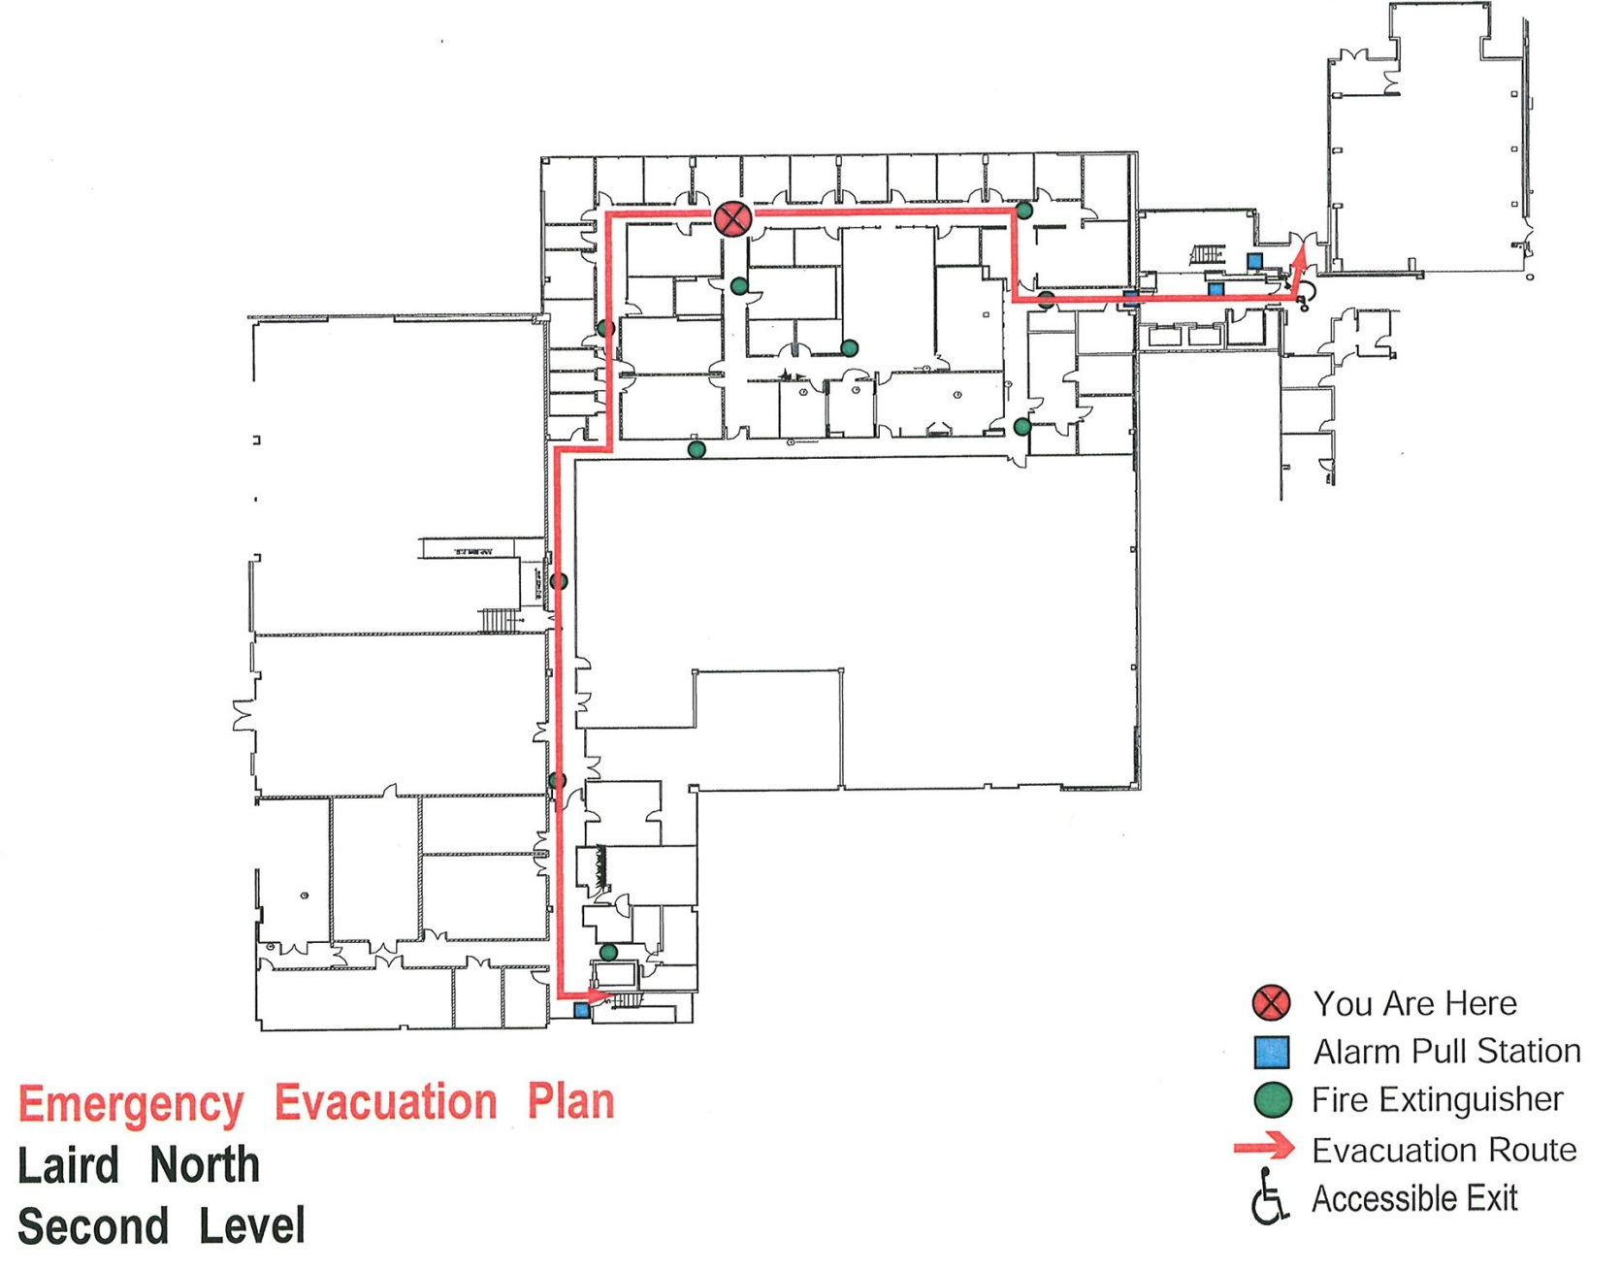
Fire Evacuation Map – ML8
Emergency Evacuation Plan
Laird North
Second Floor

Slide 7
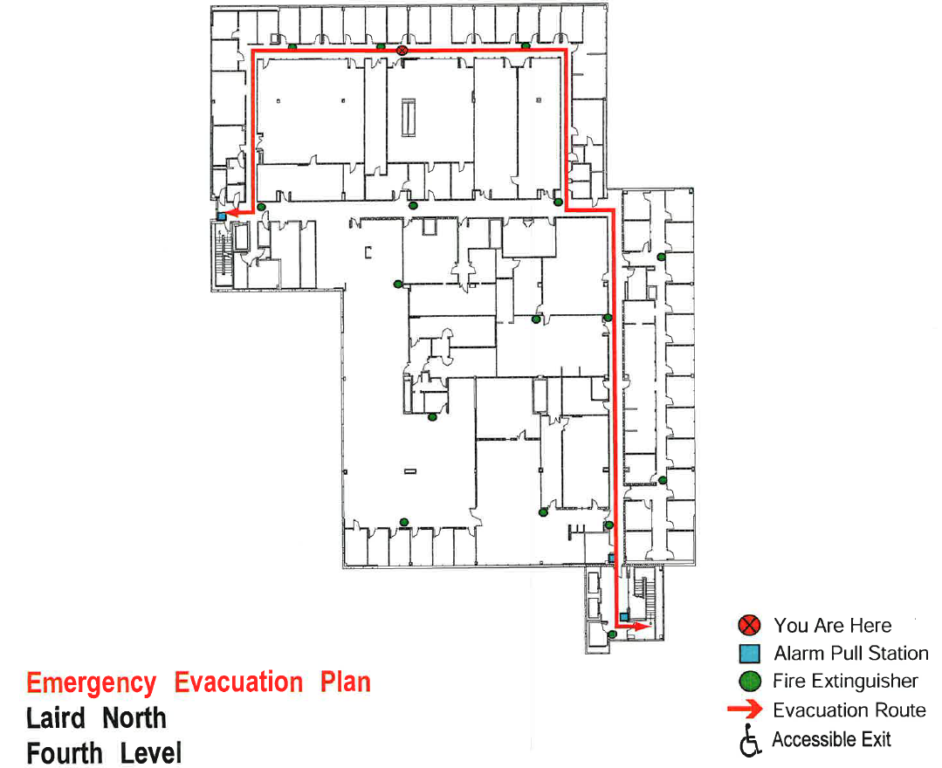
Fire Evacuation Map – MLR
Emergency Evacuation Plan
Laird North
Fourth Floor

Slide 8
Update on Department Call-In Procedure
Call 715-221-7090 (CPMR department line) if you are going to be out or more than 15 minutes later than your normal start time. Please add this number to your mobile device for convenience.
From MCHS Employee Attendance Policy:
3.3 Employee Notification Requirements
In the rare instances where employees cannot avoid being late or are unable to work as scheduled for any reason, including FMLA, the employee must follow the department’s normal notification process. Failure to do so may result in disciplinary action, up to and including termination of employment.

Slide 9
CPMR Social Committee Update
Julie Vehrs, Hope Florence, and Jenna Schwabe have volunteered for this committee.
We would like to recruit 2-3 additional volunteers. Please contact one of these individuals by April 12, 2019 if you would like to participate.
This committee is for creating/planning CPMR social events. It does not mean you do all work (e.g. setup, cleanup, etc.) involved for these events.

Slide 10
Questions?

